Slide 1
Ms. Prerna Mahajan
Course: Data Science and AI

Slide 2
Introduction
Data filtering or summarizing is an essential process in excel for refining and analyzing datasets.
This presentation explores the methods, procedures, insights and challenges encountered while summarizing the datasets.
Refining of data leads to the accuracy of the output.

Slide 3
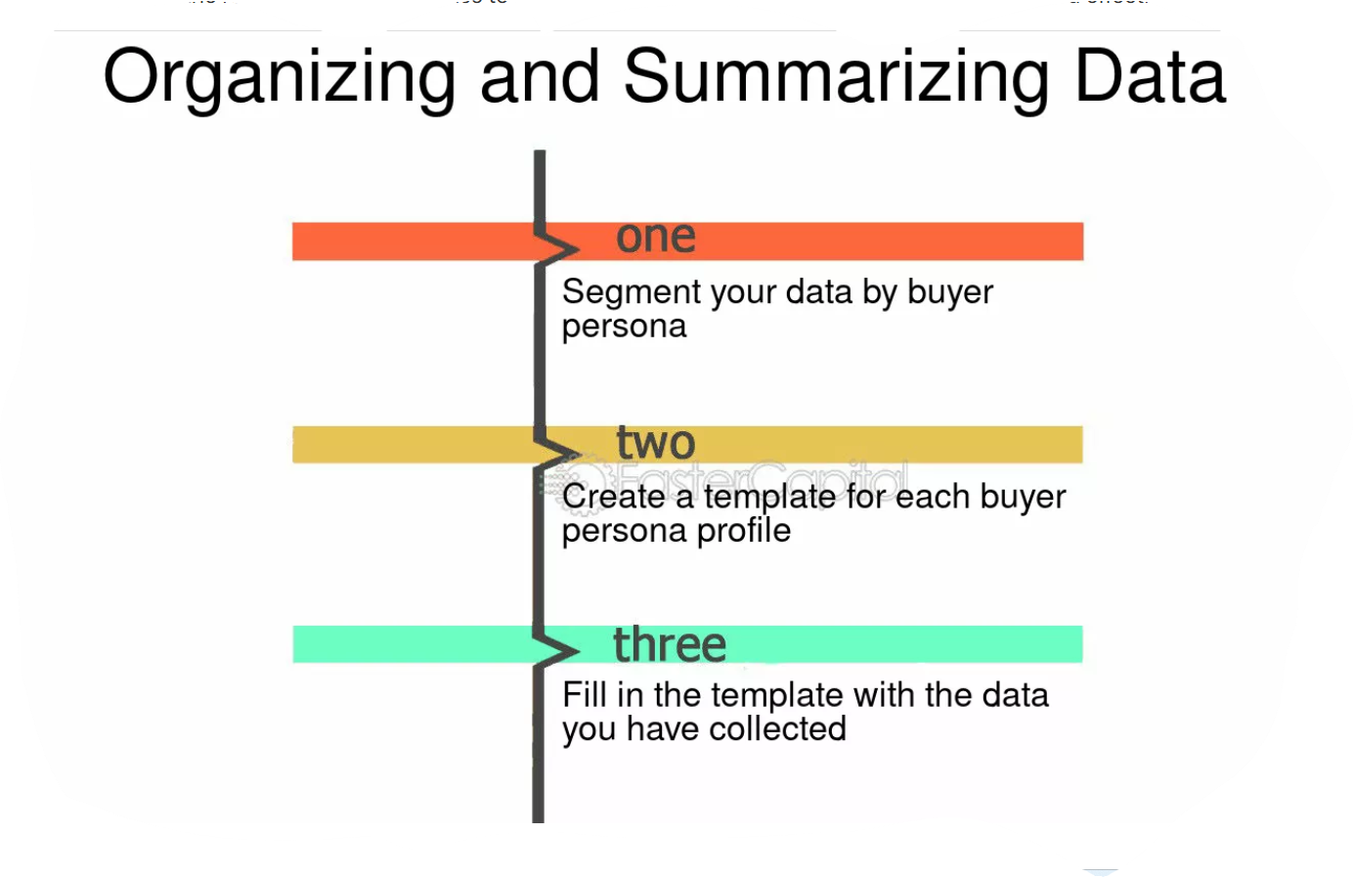
Objectives
Identify relevant data for analysis.
Remove duplicates and inconsistencies.
Apply filters and formulas for the targeted insights.
Develop best practices as per the learned or experienced practices of data.

Slide 4
Data Description
The dataset used for this project having 3 different excel files with multiple irregular columns of information.
The dataset is based on the Bike Sharing Demand in a particular season from no. of casual and registered users.
The demand is directly based on the weather situation which can be analyses by the current wind speed, temperature and humidity.
There is neither any formulas nor any formatting in the dataset provided.

Slide 5
EXCEL 2019
Microsoft excel 2019 is used for summarizing data.
We have merged data from dataset 1 and dataset 2 in “Comb 1 & 2”
First, we have removed the duplicates and merge data under proper heading.
Check for missing, duplicate and invalid entries.
Used Text function to extract date, day and year.
Used Weekday and Weekend function for data scrutinizing.
Applied filters to look for large datasets.
Applied several functions like, sum, average, min, max, if, text etc in Sheet Comb 1 & 2

Slide 6
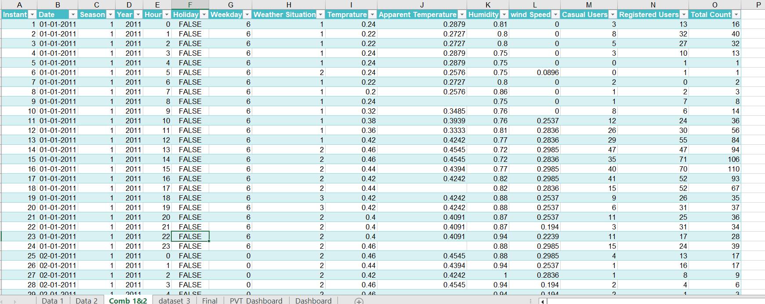

Slide 7
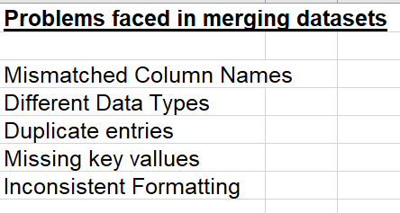
Comb 1 & 2 (Merged 2 datasets)

Slide 8
Final Dataset
Combined data set into final worksheet.
Evaluate all the necessary functions and formatting which makes the data more useful, understanding and expressive.
Cleared all unnecessary detailing and formatting.
The outcome would be condensed, organized and insightful information rather than raw data.

Slide 9
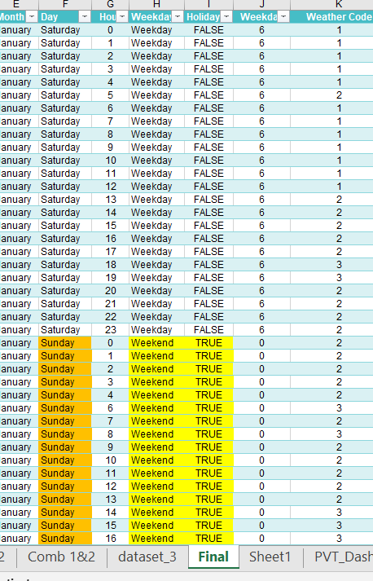
Conditional Formatting
Applied conditional formatting where needed for the easier understanding.
Given name to the weather situation code to understand the average usage of the bike per day,.

Slide 10
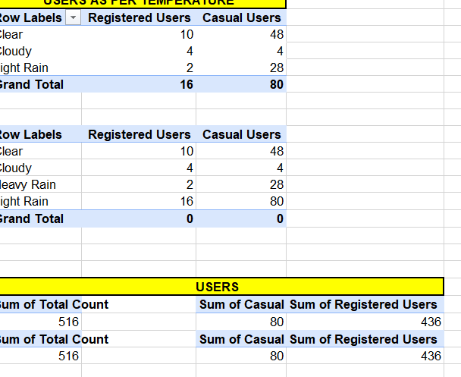
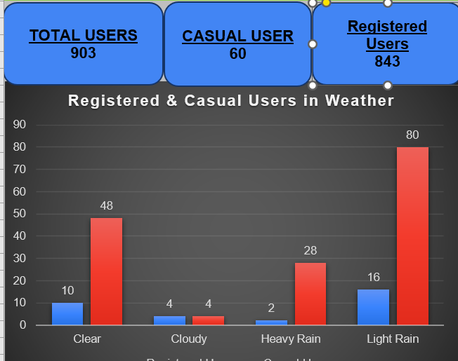
PIVOT TABLE
Added sheet of Pivot tables
Added sheet of dashboard

Slide 11
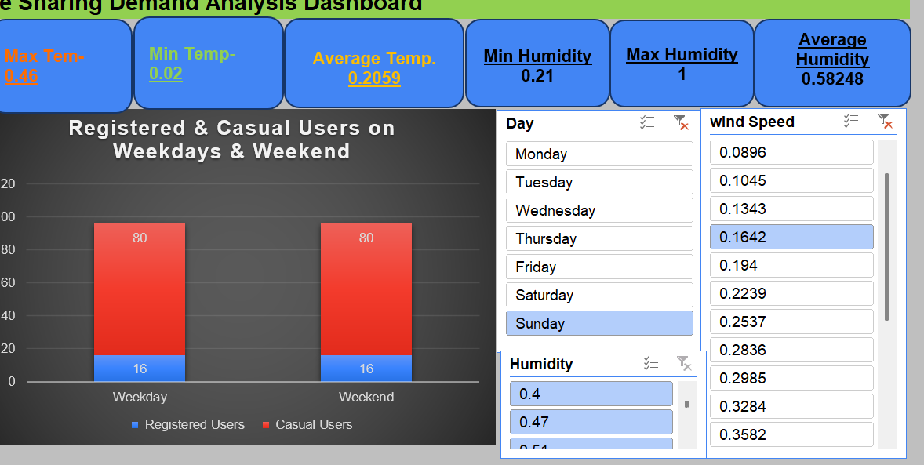

Slide 12
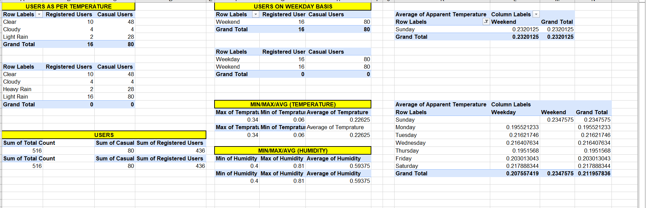

Slide 13

PROJECT FINISH
“Data doesn’t just tell us where we’ve been — it shows us where to go next.”

